Slide 1
Mesh Walkie Talkie Research
ECEN/CSCE 403 Capstone
Jaiah, Ryan, Junsu, Cole

Slide 2
Subsystem Split
Power System - Junsu
Be able to power multiple systems
Low power, transmission, and shut-down power systems
Rechargeable Li Battery (1.8 - 3.8 MCU supply Voltage)
Audio System - Ryan
Audio sampling/audio compression
Push-to-talk
ADC/DAC conversions
Mesh/RF system - Cole/Jaiah
Mesh algorithm/software (challenge)
Gateway Node system
MCU software/other hardware system - Team (next semester)
All other MCU software
Launchpad hardware integration with other components
Case Hardware/display hardware/push-to-talk hardware etc.

Slide 3
Mesh System
Zigbee
Wi-SUN*
Pros | Cons
Well established, abundant support | 2.4 GHz band (congestion, interference heavy)?
Higher data rate for increased audio quality | Larger power consumption
Low latency
In order to avoid using a main hub in our mesh topology, Wi-SUN would likely be the better option. Although abundant support exists for Zigbee, Wi-SUN is naturally designed for decentralized mesh networking, without the need for a central hub or coordinator. This allows for a more flexible deployment of walkie-talkies that can communicate directly with each other or relay messages through other nodes.
Pros | Cons
Longer Range | Lower data rate, increased latency
Lower Power Consumption | Less maturity in consumer market
Less Interference | Potentially more complex, less support

Slide 4
Mesh System (Continued)
Wi-SUN potential restraints:
IoT Focus - Wi-SUN is optimized for IoT applications, which typically involve small, intermittent data packets (like sensor readings). Continuous audio streaming is different and may introduce protocol overhead that impacts efficiency and real-time performance.
Compression Requirements - Need to compress audio to ~200Kbps minimum while maintaining low latency
Antennas - Need antennas compatible with the sub-1 GHz band to transmit and receive signals. Included in LP?

Slide 5
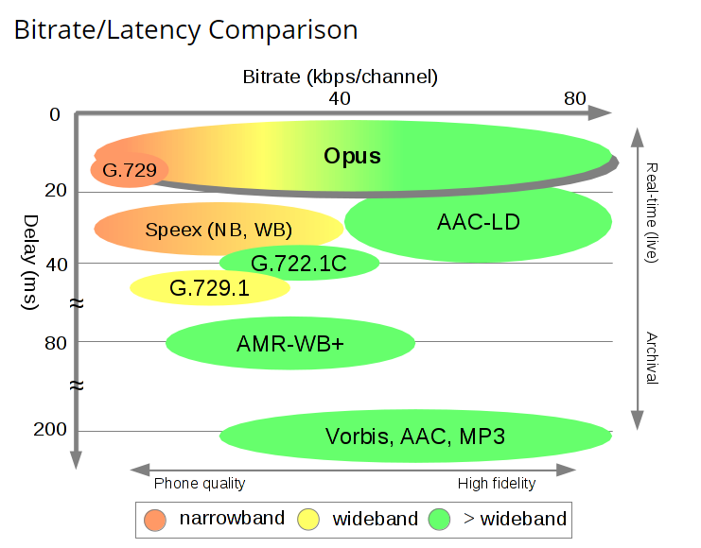
Voice Coder (Compression) Algorithms
Opus Codec
Meets all of the minimum system requirements
Bitrates from 6 kb/s to 510 kb/s
Sampling rates from 8 kHz (narrowband) to 48 kHz (fullband)
All of the resources are open source
Has Speech Support
Designed for low latency

Slide 6
Power System
Rechargeable Lithium Battery
Have a low power mode available when device is not being used
Battery Management System (BMS)
Prevent overcharging the battery or discharging the battery
Monitor the temperature of the battery to make sure it doesn’t overheat
Check voltages and currents
State of Charge (SoC)
State of Health (SoH)
Power distribution
Make sure all loads are efficiently receiving power
All power converters are being used efficiently
Make sure each subsystem gets the right type of power (AC/DC) and the right values

Slide 7
Questions
Subsystem Split - How can we develop individually to demo at the end of the semester?
Hello World - walkthrough of launchpad “hello world” c code post CCS, SDK download. (SimpleLinkSDK? SMARTRFTM Studio?)
PCB design? Are we using the launchpads in the final implementation?
Other part purchases: LCD, Analog Audio, Batteries
How many launchpads can we get? - many RF/Mesh demos require more than one launchpad

Slide 8
Sources
https://www.uniconvergetech.in/blog/wi-sun-networks
https://opus-codec.org/

